Slide 1
Training DNN (Avoiding Overfitting)
1Lt Chad MacWilkinson
Capt Jenn Allsop
Capt Brian Popick

Slide 2
Overview
UPDATED
What is overfitting?
How do we avoid overfitting?
Hint: through regularization techniques
How do we implement regularization techniques?

Slide 3
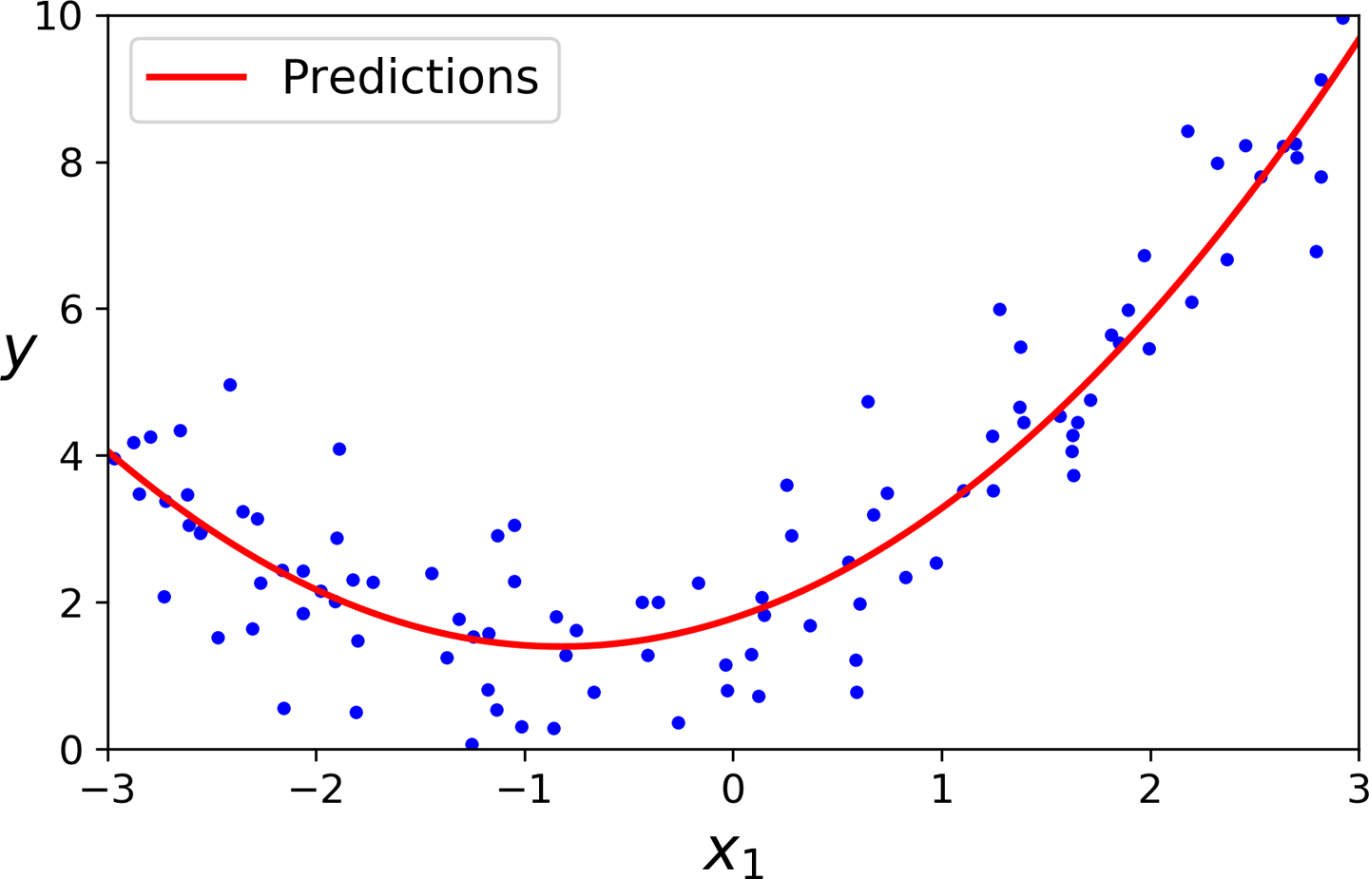
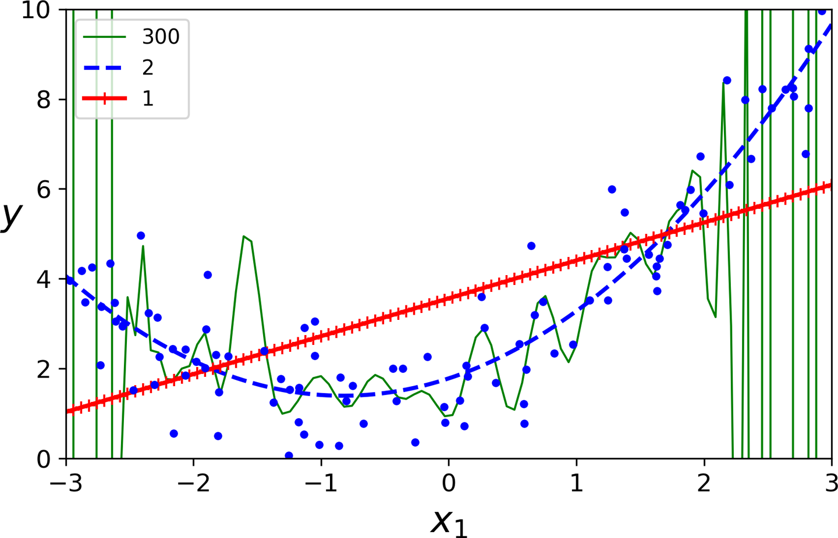


What is overfitting?
overfitting the training data
$$\hat{y}=0.56x_{1}^{2}+0.93x_{1}+1.78$$
$$\hat{y}=0.56x_{1}^{2}+0.93x_{1}+1.78$$
* Hands-On Machine Learning with Scikit-Learn, Keras, and TensorFlow, 2nd Edition, Figures 4.13 and 4.14
underfitting the training data
Notes:
Model is too specific to the training data; it loses generality making it a poor predictor when new data is introduced to it.
Assume the model in the left graph is adequate. On the right, we see a case of an overfit and an underfit examples. In the underfit case, we see that the model is essentially linear and doesn’t capture the overall trend of the data. If we were to look at the model metrics, such as R^2, and MSE they would be pretty bad. . In the overfit example we see that the model is essentially playing connect the dots between the data points. Inspection of the model metrics would probably show good R^2 and low MSE values, but if new data points were introduced, their prediction could be quite poor.

Slide 4
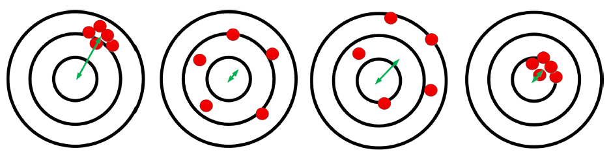
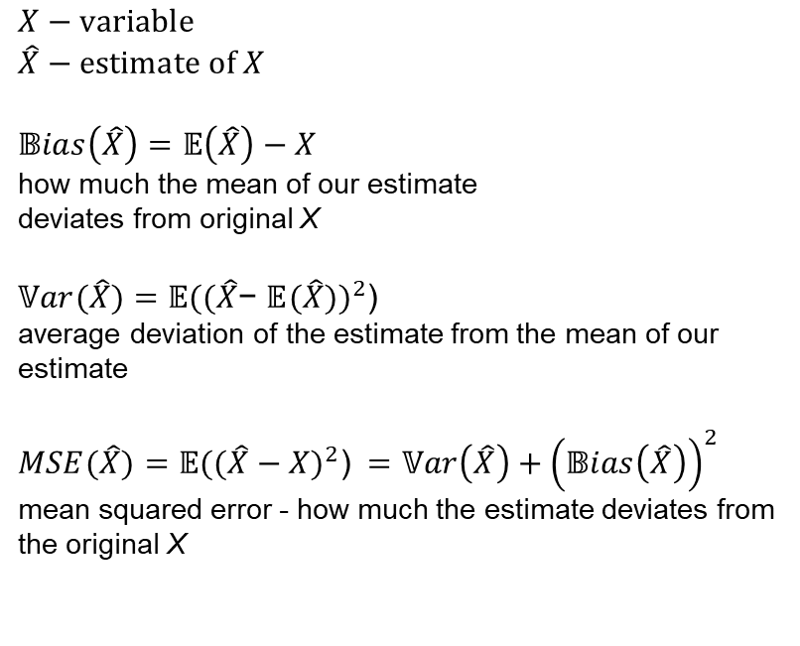
What is overfitting?
worst case
best case
$$X−variable$$
$$\hat{X}−estimate of X$$
$$𝔹ias\left(\hat{X}\right)=𝔼\left(\hat{X}\right)−X$$
how much the mean of our estimate
deviates from original X
$𝕍ar(\hat{X})={𝔼((\hat{X}\text{− }𝔼(\hat{X}))}^{2}$)
average deviation of the estimate from the mean of our estimate
$$MSE(\hat{X})={𝔼((\hat{X}−X)}^{2}\text{)} =𝕍ar\left(\hat{X}\right)+{\left(𝔹ias\left(\hat{X}\right)\right)}^{2}$$
mean squared error - how much the estimate deviates from the original X
high bias
low variance
low bias
high variance
high bias
high variance
low bias
low variance
test
training
* The Theory Behind Overfitting, Cross Validation, Regularization, Bagging, and Boosting: Tutorial, 28 Mar 2019, Ghojogh and Crowley
Notes:
To avoid overfitting, we must balance the bias/variance trade-off. As one increases, the other decreases, meaning there is a happy – or acceptable – middle ground.
Bias: how far off our mean guess is from the original x. If guess is ‘far’ away from actual, we have high bias. If close, we have low bias
Occurs from wrong assumptions: high bias model is likely underfit (pg. 134)
Variance: how spread-out guesses are. If the spread is large, we have high variance. If the spread is small, we have low variance
Occurs due to model's excessive sensitivity to small variations in data. Complex models (like high degree polys) are likely to have high variance and overfit(pg. 134)
Ideally, want low bias and low variance, but in practice this is hard to achieve.

Slide 5
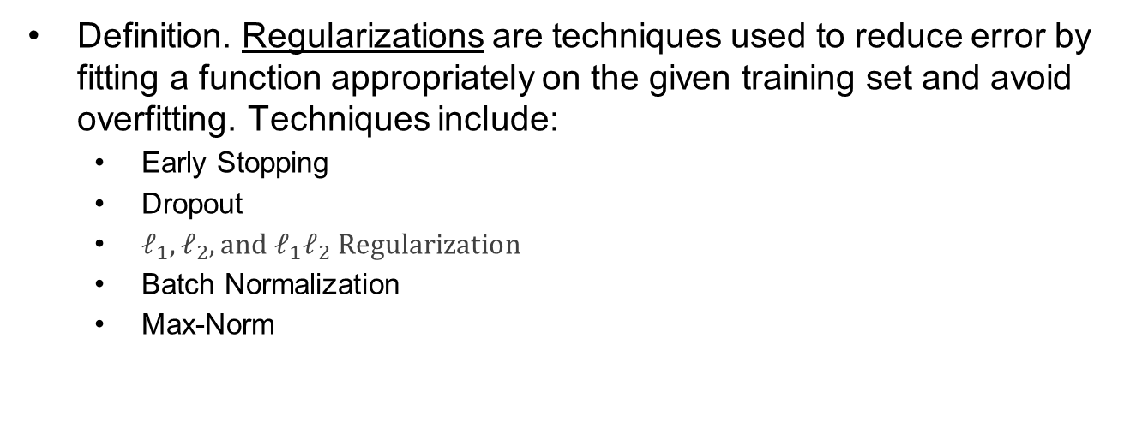
What can we do about overfitting?
Definition. Regularizations are techniques used to reduce error by fitting a function appropriately on the given training set and avoid overfitting. Techniques include:
Early Stopping
Dropout
$ℓ_{1}, ℓ_{2}, and ℓ_{1}ℓ_{2} Regularization$
Batch Normalization
Max-Norm

Slide 6
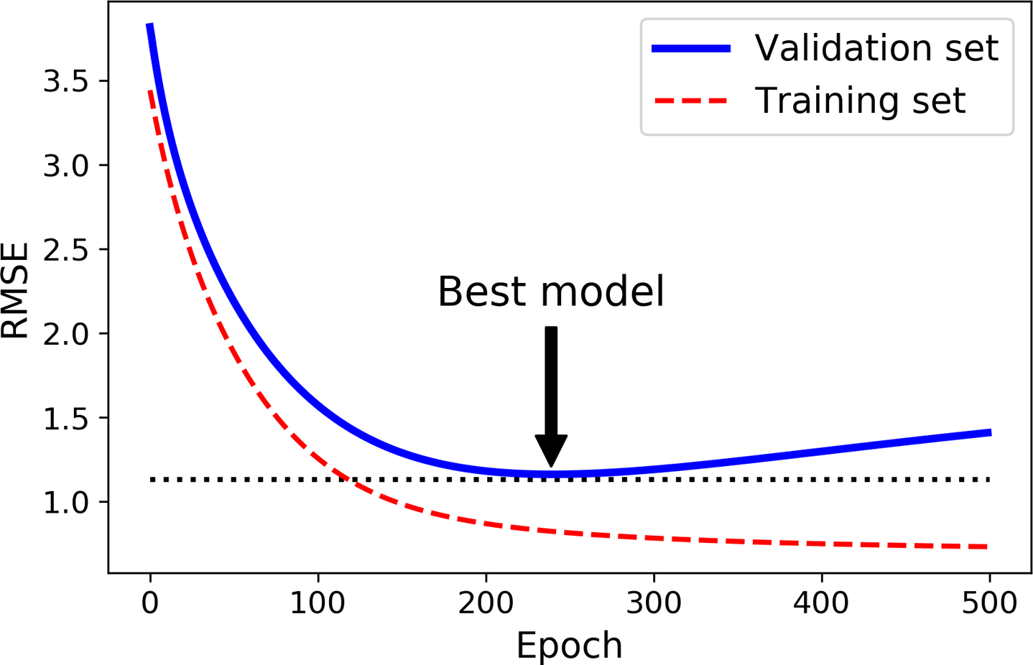
Regularizations – Early Stopping
As algorithm trains, our prediction error (RMSE) on training and validation set decrease
Overfitting begins when the validation error stops decreasing and instead starts to go back up
Early stopping - stop training when validation error reaches a minimum
May be difficult to find minimum; checkpoint it and revert if necessary
Figure 4-20. Early stopping regularization
* Hands-On Machine Learning with Scikit-Learn, Keras, and TensorFlow, 2nd Edition, Figure 4.20

Slide 7
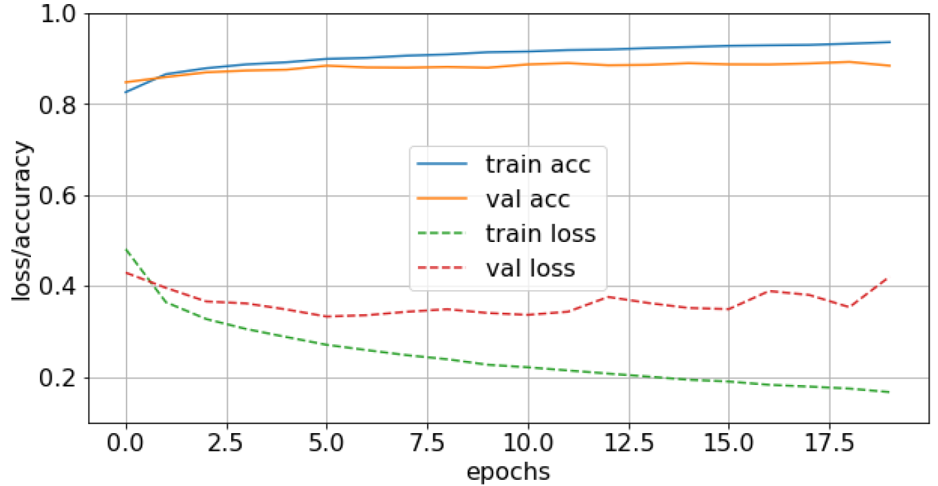
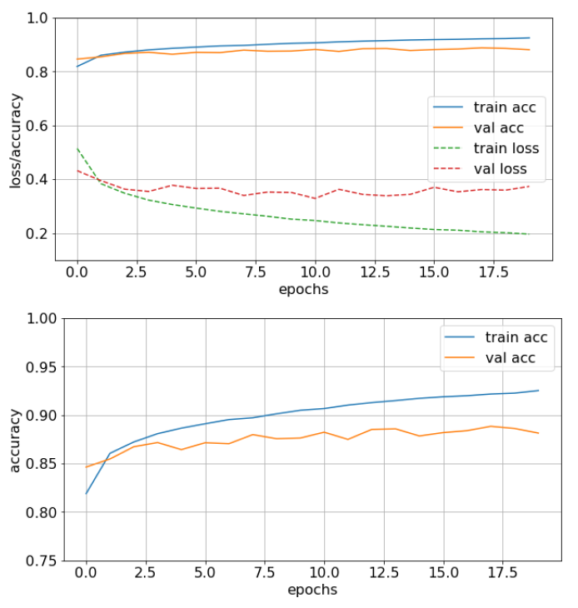
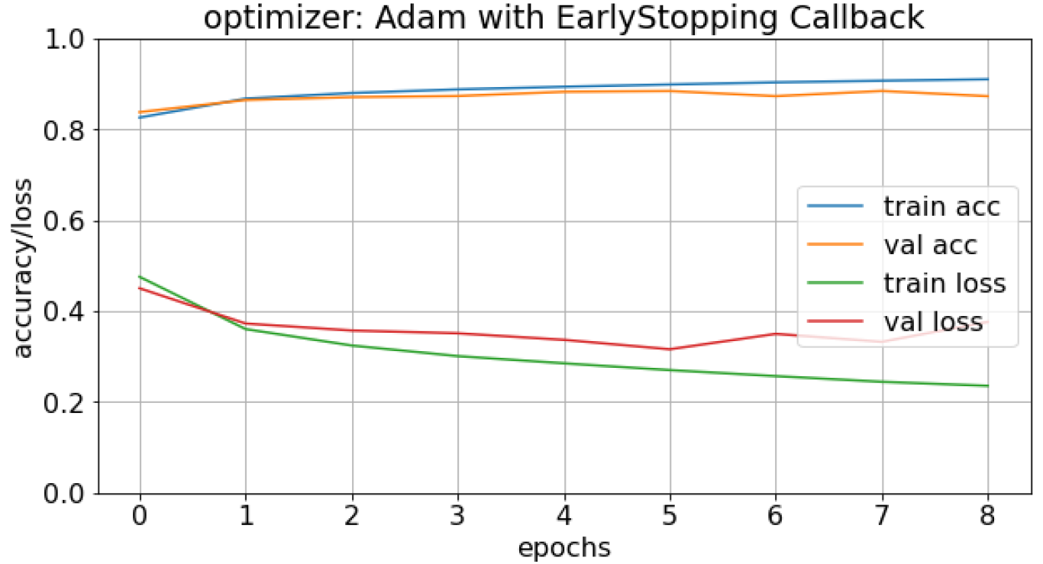
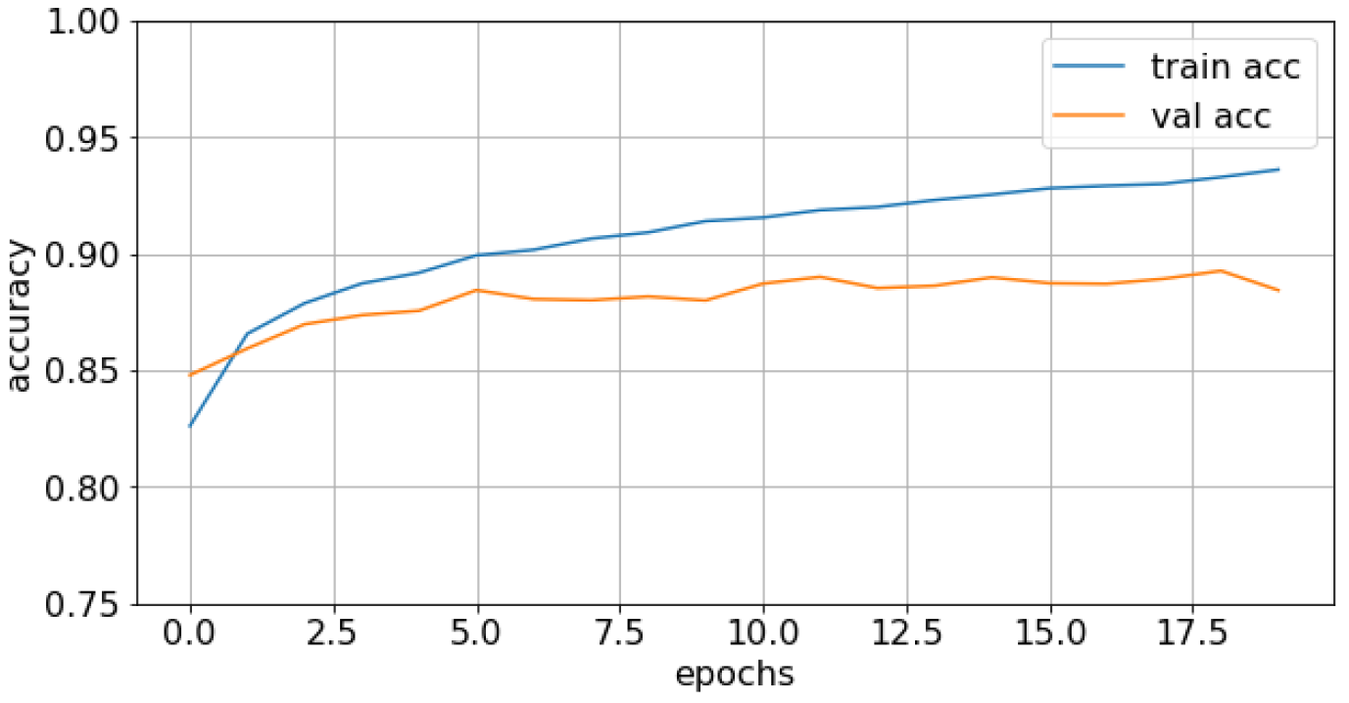
Regularizations – Early Stopping
baseline
less complex model
early stopping

Slide 8
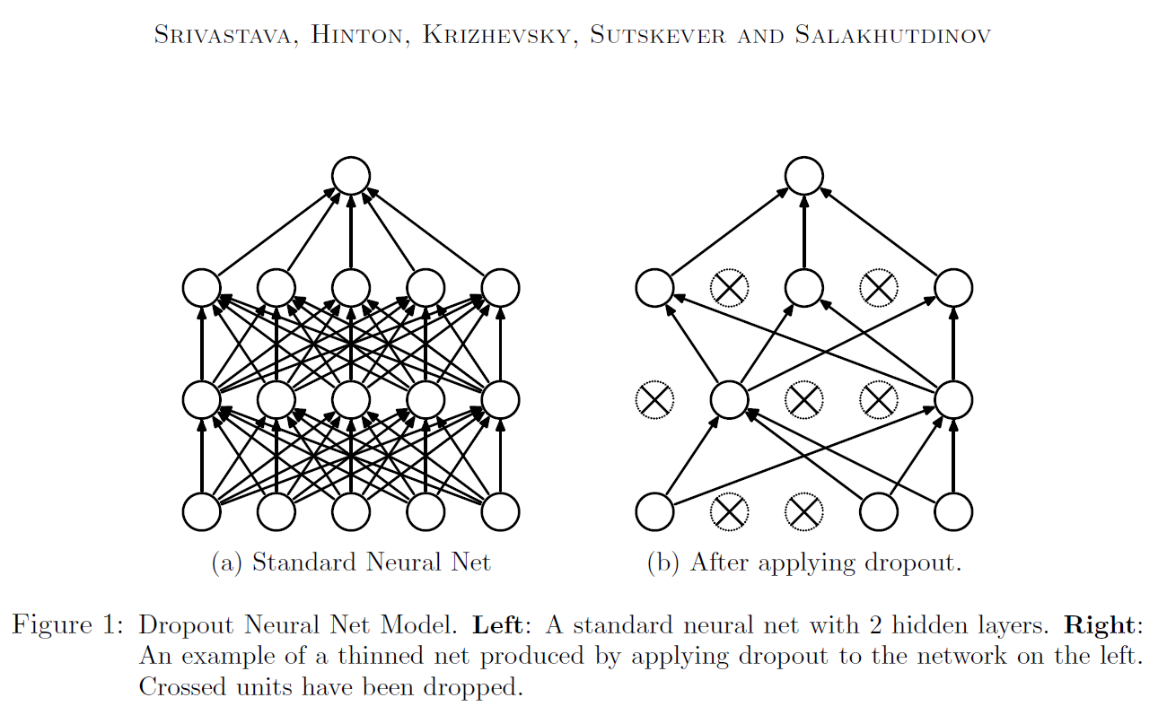
Regularizations – Dropout
At each training step, every neuron (excluding output) has probability of being temporarily dropped out (rate 10-50%)
Neurons cannot co-adapt to neighbor neurons, nor can they rely on just a few input neurons → more robust network
Avoids overfitting by “averaging ensemble” of smaller neural networks (2^N possible networks)
* Dropout: A Simple Way to Prevent Neural Networks from Overfitting, Journal of Machine Learning, 15 (2014), 1929-1958

Slide 9
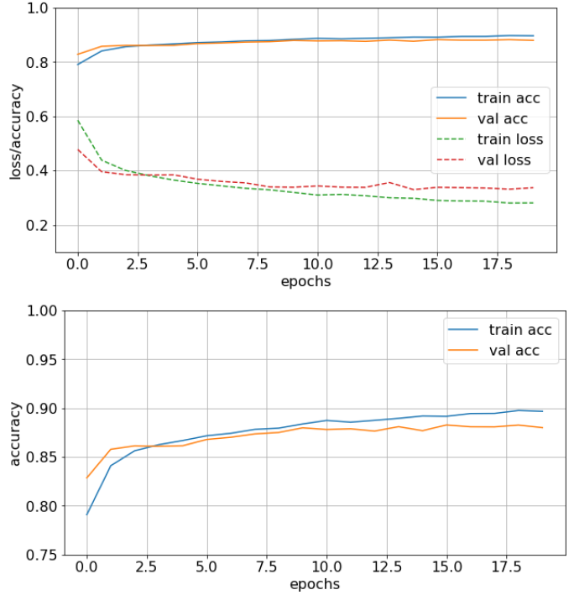
Regularizations – Dropout
baseline
dropout

Slide 10
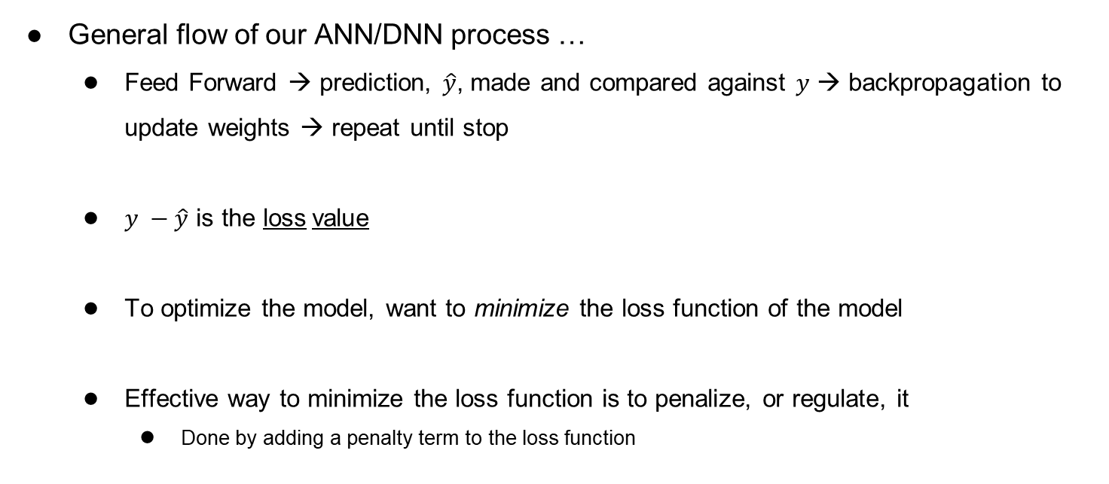
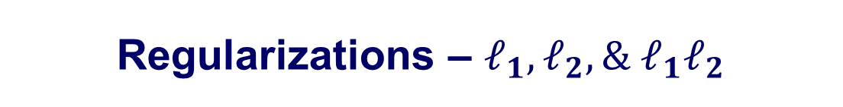
Regularizations – $ℓ_{1},ℓ_{2},\& ℓ_{1}ℓ_{2}$
General flow of our ANN/DNN process …
Feed Forward → prediction, $\hat{y}$, made and compared against $y$ → backpropagation to update weights → repeat until stop
$y −\hat{y}$ is the loss value
To optimize the model, want to minimize the loss function of the model
Effective way to minimize the loss function is to penalize, or regulate, it
Done by adding a penalty term to the loss function

Slide 11
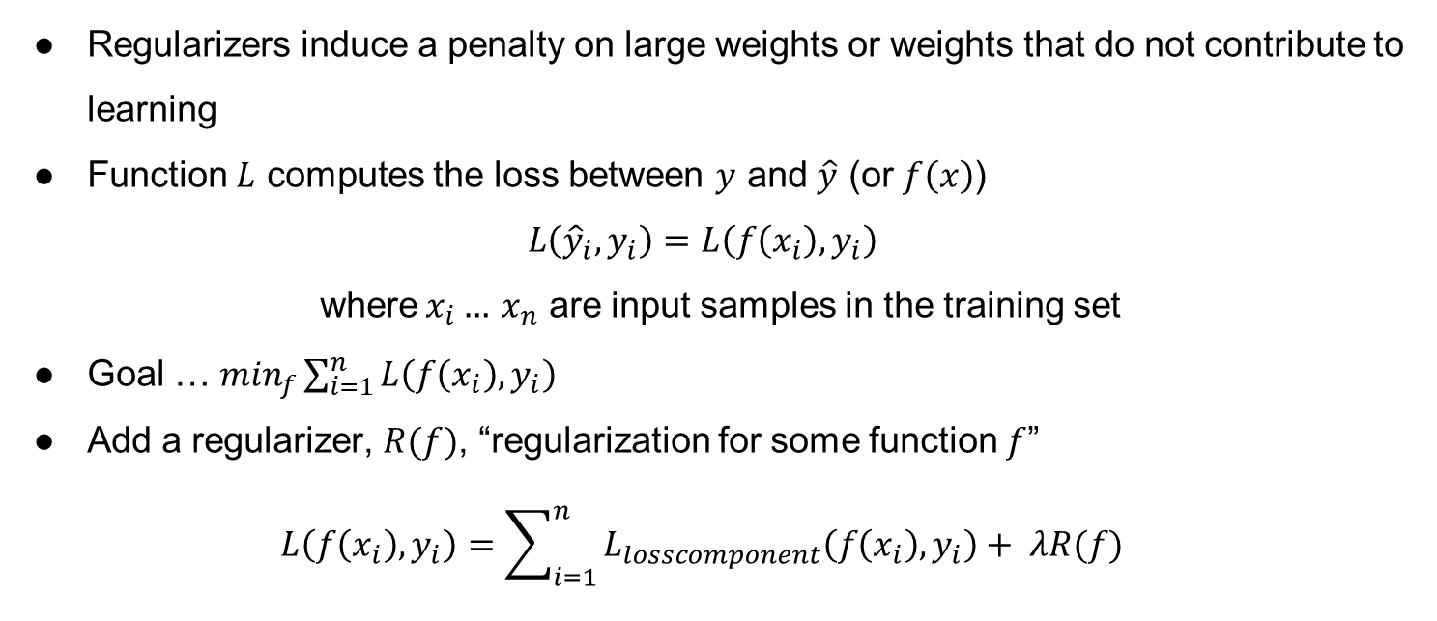

Regularizations – $ℓ_{1},ℓ_{2},\& ℓ_{1}ℓ_{2}$
Regularizers induce a penalty on large weights or weights that do not contribute to learning
Function $L$ computes the loss between $y$ and $\hat{y}$ (or $f\left(x\right)$)
$$L\left({\hat{y}}_{i},y_{i}\right)=L\left(f\left(x_{i}\right),y_{i}\right)$$
where$x_{i}…$ $x_{n}$ are input samples in the training set
Goal … $\min_{f}\sum_{i=1}^{n}{L\left(f\left(x_{i}\right),y_{i}\right)}$
Add a regularizer, $R(f)$, “regularization for some function $f$”
$$L\left(f\left(x_{i}\right),y_{i}\right)=\sum_{i=1}^{n}{L_{losscomponent}\left(f\left(x_{i}\right),y_{i}\right)+ λR(f)}$$
we control $λ$

Slide 12
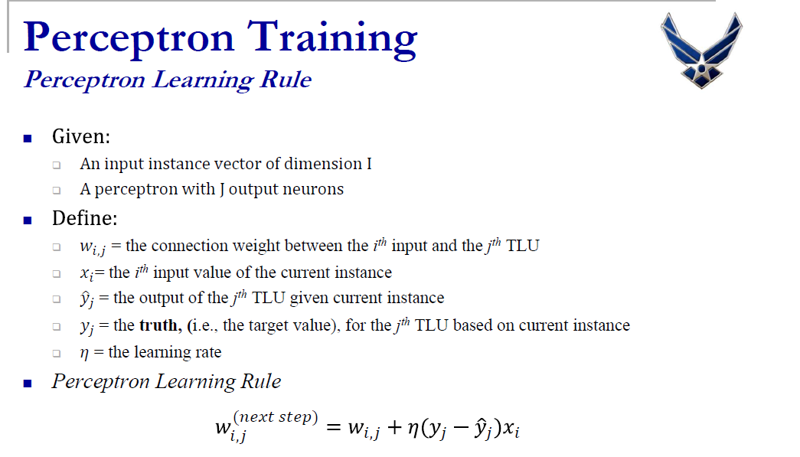
Regularizations – $ℓ_{1},ℓ_{2},\& ℓ_{1}ℓ_{2}$
We’ve done this ‘minimize loss function’ before …
loss function

Slide 13
Regularizations – $ℓ_{1},ℓ_{2},\& ℓ_{1}ℓ_{2}$
Common regularizations for linear regression models include:
L2 regularization (Ridge)
L1 regularization (Lasso)
L1L2 regularization (Elastic Net)
All three available in Keras
https://github.com/christianversloot/machine-learning-articles/blob/main/what-are-l1-l2-and-elastic-net-regularization-in-neural-networks.md → good explanation of all three
Notes:
Do not use any of these when using the ‘selu’ activation function (https://github.com/ageron/handson-ml2/blob/master/11_training_deep_neural_networks.ipynb). Due to the nature of the selu keeping the mean and variance constant across layers, regularizing the loss function will break the selu activation
Of note, shouldn’t regularize the selu anyway (https://github.com/ageron/handson-ml2/blob/master/11_training_deep_neural_networks.ipynb).

Slide 14

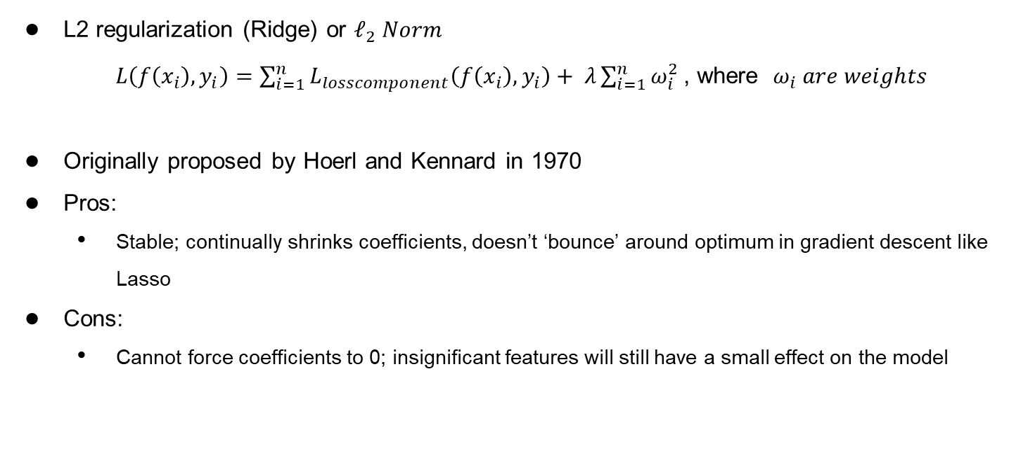
Regularizations – $ℓ_{1},ℓ_{2},\& ℓ_{1}ℓ_{2}$
L2 regularization (Ridge) or $ℓ_{2} Norm$
$L\left(f\left(x_{i}\right),y_{i}\right)=\sum_{i=1}^{n}{L_{losscomponent}\left(f\left(x_{i}\right),y_{i}\right)+ λ\sum_{i=1}^{n}{ω_{i}^{2}}}$ , where ${ ω}_{i} are weights$
Originally proposed by Hoerl and Kennard in 1970
Pros:
Stable; continually shrinks coefficients, doesn’t ‘bounce’ around optimum in gradient descent like Lasso
Cons:
Cannot force coefficients to 0; insignificant features will still have a small effect on the model
we control $λ$
KENNARD, ARTHURE HOERLAND ROBERTW. "Ridge Regression: Applications to Nonorthogonal Problems." Technometrics 12.1 (1970): 69-82.
Notes:
Probably the most common regularization technique of the 3 presented
Typically use a small value for lambda, like 0.001 or 0.0001

Slide 15

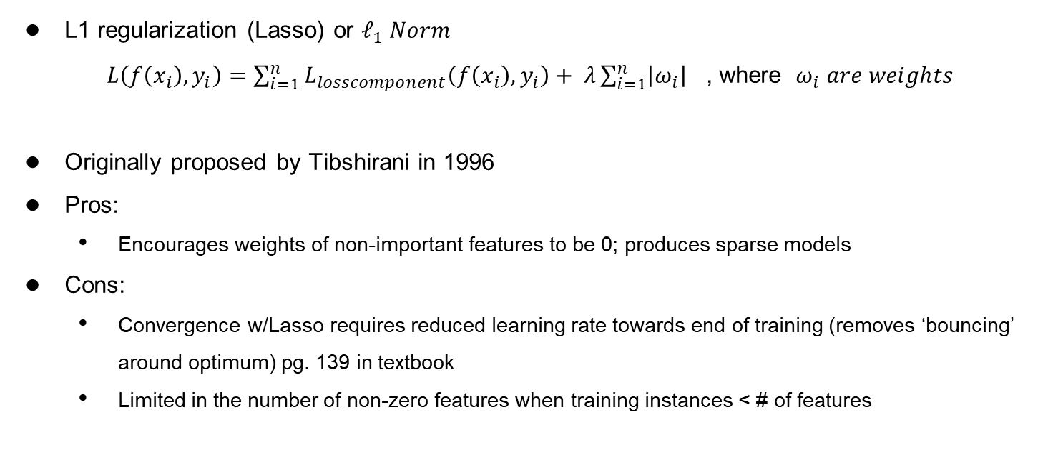
Regularizations – $ℓ_{1},ℓ_{2},\& ℓ_{1}ℓ_{2}$
L1 regularization (Lasso) or $ℓ_{1} Norm$
$L\left(f\left(x_{i}\right),y_{i}\right)=\sum_{i=1}^{n}{L_{losscomponent}\left(f\left(x_{i}\right),y_{i}\right)+ λ\sum_{i=1}^{n}{\left|ω_{i}\right|}}$ , where ${ ω}_{i} are weights$
Originally proposed by Tibshirani in 1996
Pros:
Encourages weights of non-important features to be 0; produces sparse models
Cons:
Convergence w/Lasso requires reduced learning rate towards end of training (removes ‘bouncing’ around optimum) pg. 139 in textbook
Limited in the number of non-zero features when training instances < # of features
we control $λ$
TIBSHIRANI, ROBERT. "Regression Shrinkage and Selection via the Lasso." Journal of the Royal Statistical Society. Series B (Methodological) 58.1 (1996): 267-288.
Notes:
Typically use a small value for lambda, like 0.001 or 0.0001
Also of note, in Keras do not use the l1 norm when using the selu activation function

Slide 16

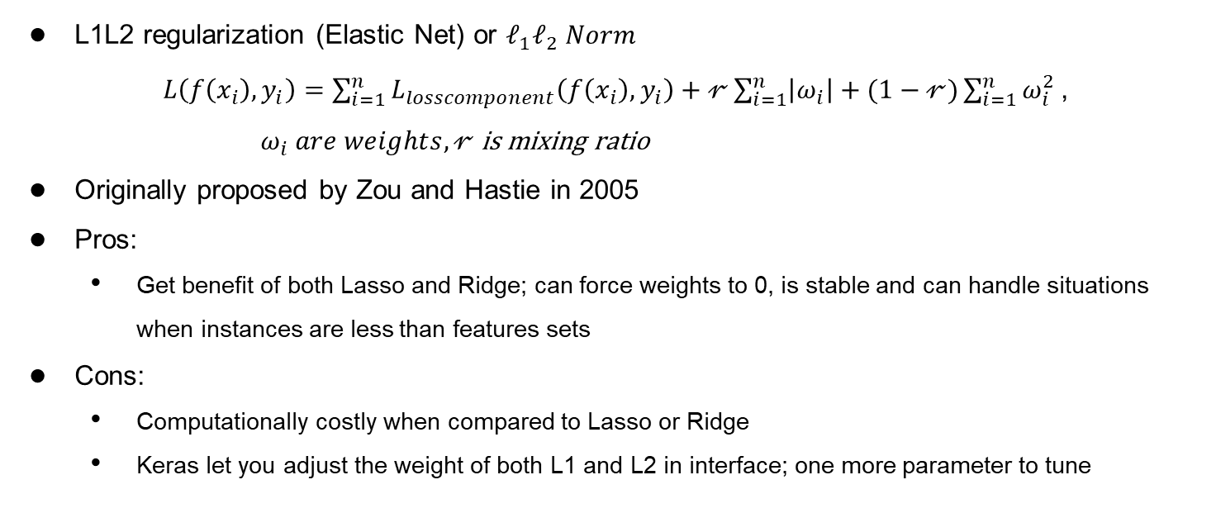
Regularizations – $ℓ_{1},ℓ_{2},\& ℓ_{1}ℓ_{2}$
L1L2 regularization (Elastic Net) or $ℓ_{1}ℓ_{2} Norm$
$L\left(f\left(x_{i}\right),y_{i}\right)=\sum_{i=1}^{n}{L_{losscomponent}\left(f\left(x_{i}\right),y_{i}\right)+𝓇\sum_{i=1}^{n}{\left|ω_{i}\right|}+(1−𝓇)\sum_{i=1}^{n}{ω_{i}^{2}}}$ ,
$ω_{i} are weights, 𝓇$ is mixing ratio
Originally proposed by Zou and Hastie in 2005
Pros:
Get benefit of both Lasso and Ridge; can force weights to 0, is stable and can handle situations when instances are less than features sets
Cons:
Computationally costly when compared to Lasso or Ridge
Keras let you adjust the weight of both L1 and L2 in interface; one more parameter to tune
we control $𝓇$
Zou, Hui, and Trevor Hastie. "Regularization and variable selection via the elastic net." Journal of the royal statistical society: series B (statistical methodology) 67.2 (2005): 301-320.
Notes:
0 < r < 1; essentially weights which norm to favor more
When r = 1, l1 norm
When r = 0, l2 norm

Slide 17
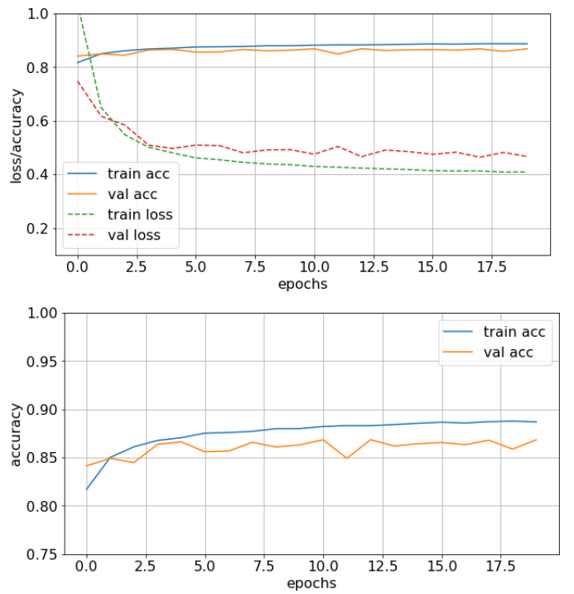
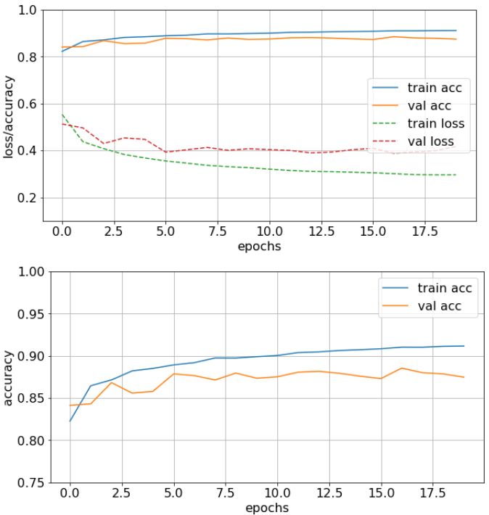
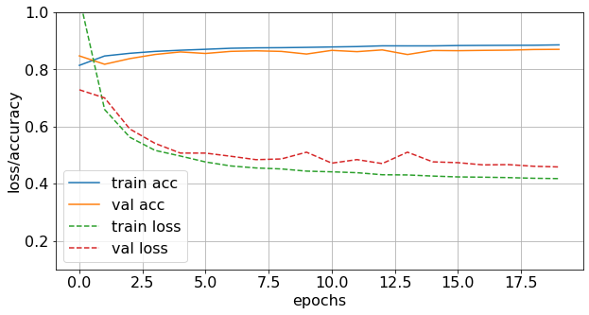
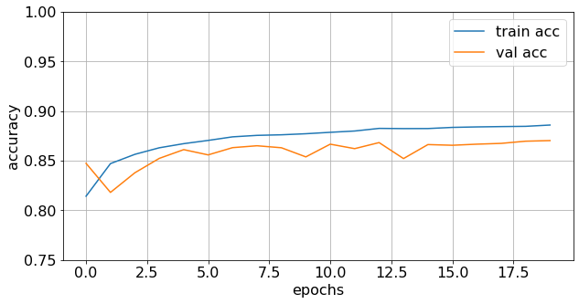
Regularizations – $ℓ_{1},ℓ_{2},\& ℓ_{1}ℓ_{2}$
baseline
L1
L2
L1L2

Slide 18
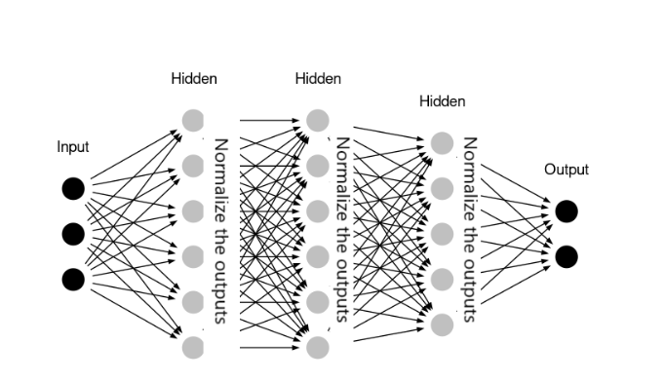
Regularizations – Batch Normalization
Batch Normalization helps help alleviate the unstable gradients
As a side benefit, it can help reduce overfitting
* Hands-On Machine Learning with Scikit-Learn, Keras, and TensorFlow, 2nd Edition, Figure 4.20

Slide 19
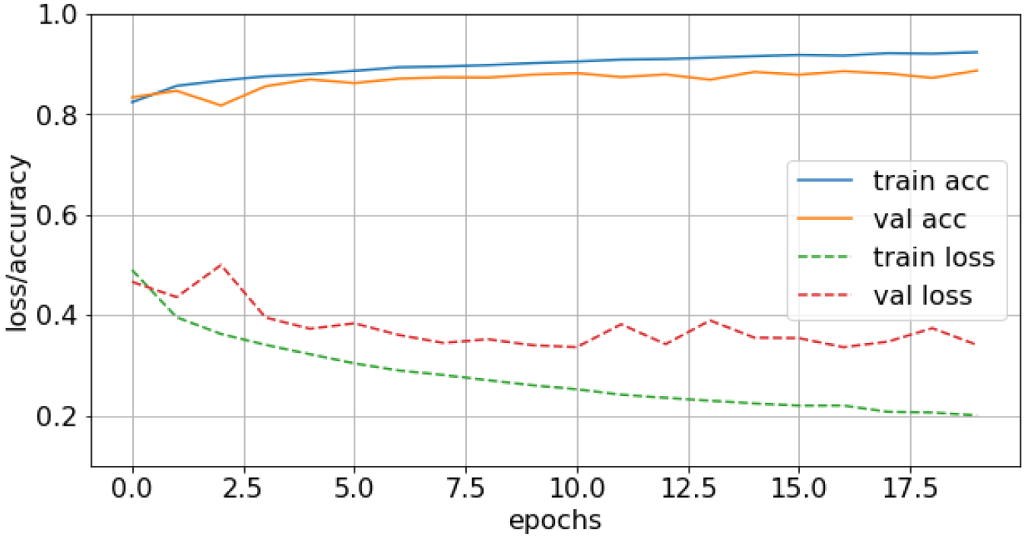
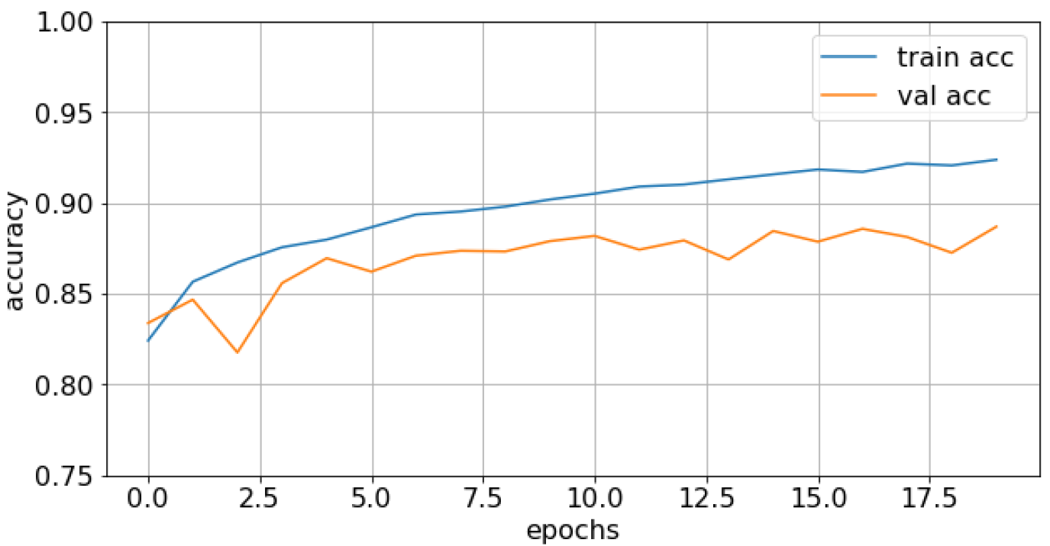
Regularizations – Batch Normalization
baseline
batch normalization

Slide 20
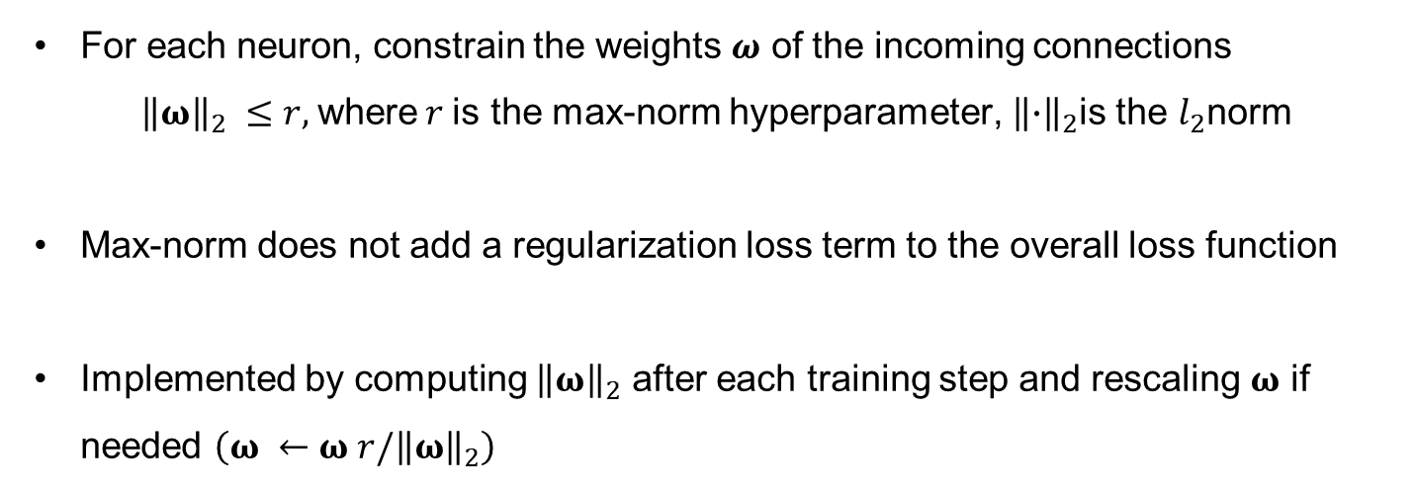
Regularizations – Max-Norm
For each neuron, constrain the weights $ω$ of the incoming connections
${\left\|ω\right\|}_{2} ≤r,$where$r$is the max-norm hyperparameter, ${\left\|∙\right\|}_{2}$is the $l_{2}$norm
Max-norm does not add a regularization loss term to the overall loss function
Implemented by computing ${\left\|ω\right\|}_{2}$ after each training step and rescaling $ω$ if needed $\left({ω ←ω r/\left\|ω\right\|}_{2}\right)$
* Hands-On Machine Learning with Scikit-Learn, Keras, and TensorFlow, 2nd Edition, Ch 11 – max-norm section
Notes:
R or c, is the max-norm hyperparameter. Typical values of r are on orders of 3 or 4. One of its appealing properties is that network cannot explode even when the learning rates are set too high because the updates are always bounded.

Slide 21
Layer weight constraints
Max Norm: force weights to have a magnitude at or below a given limit
Non-negative: force weights to have a positive magnitude
Unit Norm: force weights to have a magnitude of 1.0
Min-Max Norm: to force weights to have a magnitude between a range
* Hands-On Machine Learning with Scikit-Learn, Keras, and TensorFlow, 2nd Edition, Ch 11 – max-norm section

Slide 22
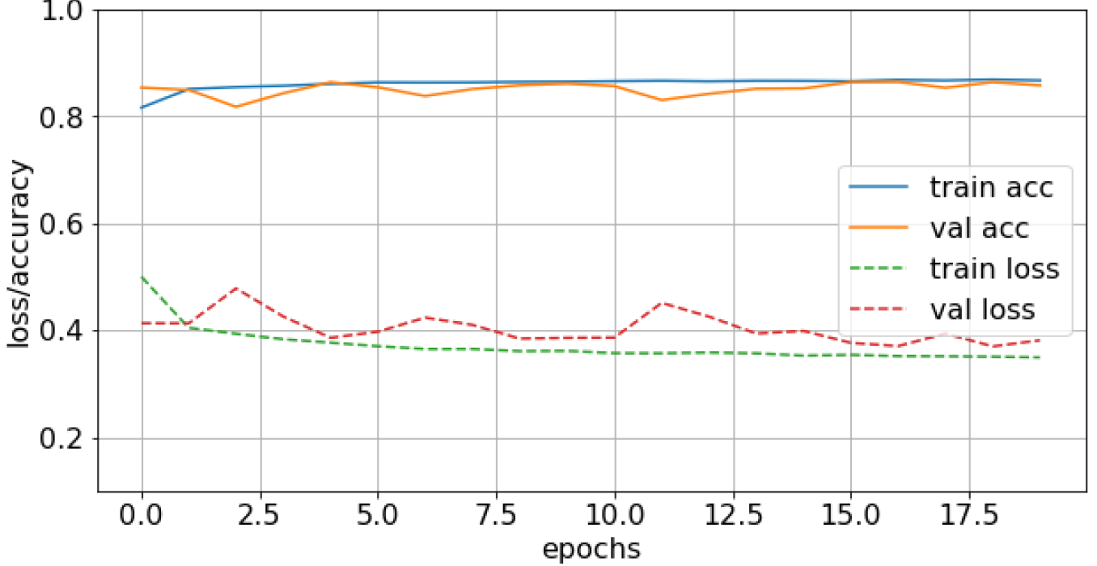
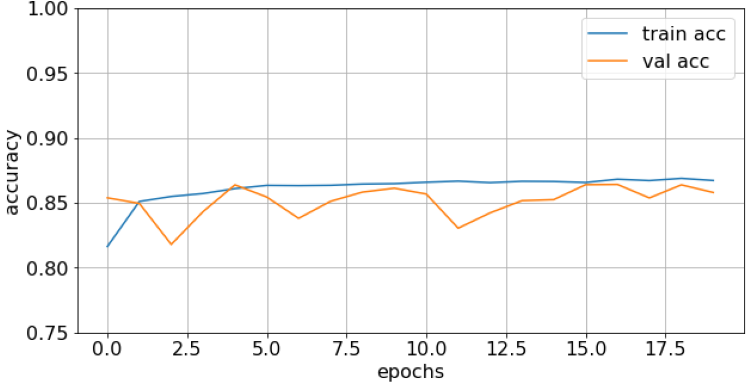
Regularizations – Max-Norm
baseline
max-norm

Slide 23
Summary
Provided a high-level description of overfitting
Different regularization techniques
Next we will show you how to implement this in Keras
Notes:
Used Tensorflow 2.0/Keras API to demonstrate regularization techniques

Slide 24
Questions

